Slide 1
SDK App Training

Slide 2
Overall Training Agenda
Day | Session | Topics
18 Jul 2022 | Morning | About OpsRramp
 |  | High level components
 |  | Basics concepts
 | Afternoon | App Development
 |  | Message Flows
19 Jul 2022 | Morning | Sample App Development
 | Afternoon | Setting up environment to test Sample App
20 Jul 2022 | Morning | Hackathon - Develop a new SDK v2 APP Powerflex..
 | Afternoon | Hackathon - Develop a new SDK v2 APP Powerflex..
 |  | Closing Session

Slide 3
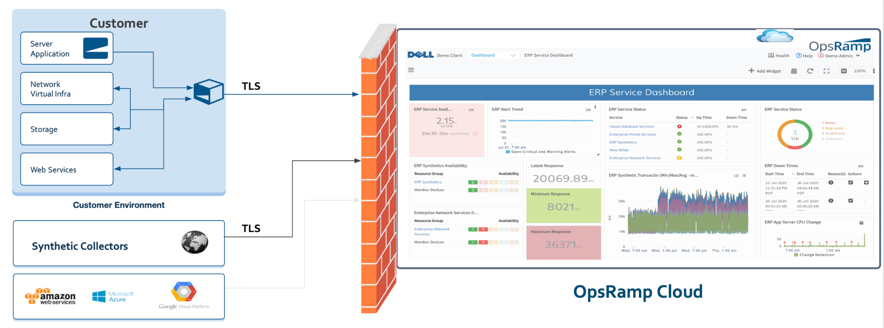
OpsRamp Deployment Model

Slide 4
Overall Training Agenda
Basic Concepts
App Development
Message Flows

Slide 5
Overall Training Agenda
Basic Concepts
High Level Components
Resources
Resource Types <> Native Types
Relationships
Metrics
Monitors
Template
DMP
App Development
Message Flows

Slide 6

High Level Solution - Components
Target Device
on-prem
OpsRamp SaaS
(Cloud)
Any Storage Device/Service
Any Network Device/Service
Any Application
Any OS
Any Host
Gateway
Core Services
Monitoring
Apps
TLS Tunnel
REST, SMI-S, Remote CLI, SNMP etc.,

Slide 7
High Level Components
OpsRamp SaaS Platform
This is where all Discovery and Monitoring data resides in the cloud
OpsRamp on-prem gateway
This is a kubernetes enabled on-prem appliance
Runs OpsRamp’s common micro-services that interact with the cloud on Apps’ behalf
Runs Discovery and Monitoring Apps
Discovery and Monitoring App
Runs the actual app code
App, as a client, authenticates itself with the target
Interacts with the monitoring target using the protocol specific to the target
The app has no knowledge about the OpsRamp SaaS Platform. All it’s interactions are kept local to the core services on the gateway

Slide 8
Resources
Domain Specific Objects
Models objects in the target domain that are “discovered’ and then “monitored”
Storage Domain: eg: “cluster”, “volume”, “disks”, “node’, “LUN” etc.,
Network Domain: eg: “switch”, “router”, “interfaces”, etc.,
Resource Attributes
Standard attributes - common attributes independent of target domain
App attributes - target specific attributes
Target device
Resources
https://github.com/opsramp/sdk2.0/blob/main/documentation/resource.md

Slide 9
Resource Type
Target device
Identifies a resource in the target domain
“nativeType” - Type in the native target domain
Eg: “Powerflex Cluster”, “Volume Group” etc.,
“resoureType” - OpsRamp equivalent type
Native-type maps to OpsRamp’s resourceType
Eg: “Dell PowerFlex MDM Cluster ⇔ “Cluster”
Eg: “Dell PowerFlex Volume” ⇔ “Volume”
Eg: “Dell PowerFlex SDS” ⇔ “STORAGE_ARRAY_VSERVER”
Resource Attributes
Standard attributes - common attributes independent of target domain
App attributes - target specific attributes (app developer defined)
Custom attributes - end customer defined
Resource types
Resource Type 1
Resources
Resources
Resource Type 2

Slide 10
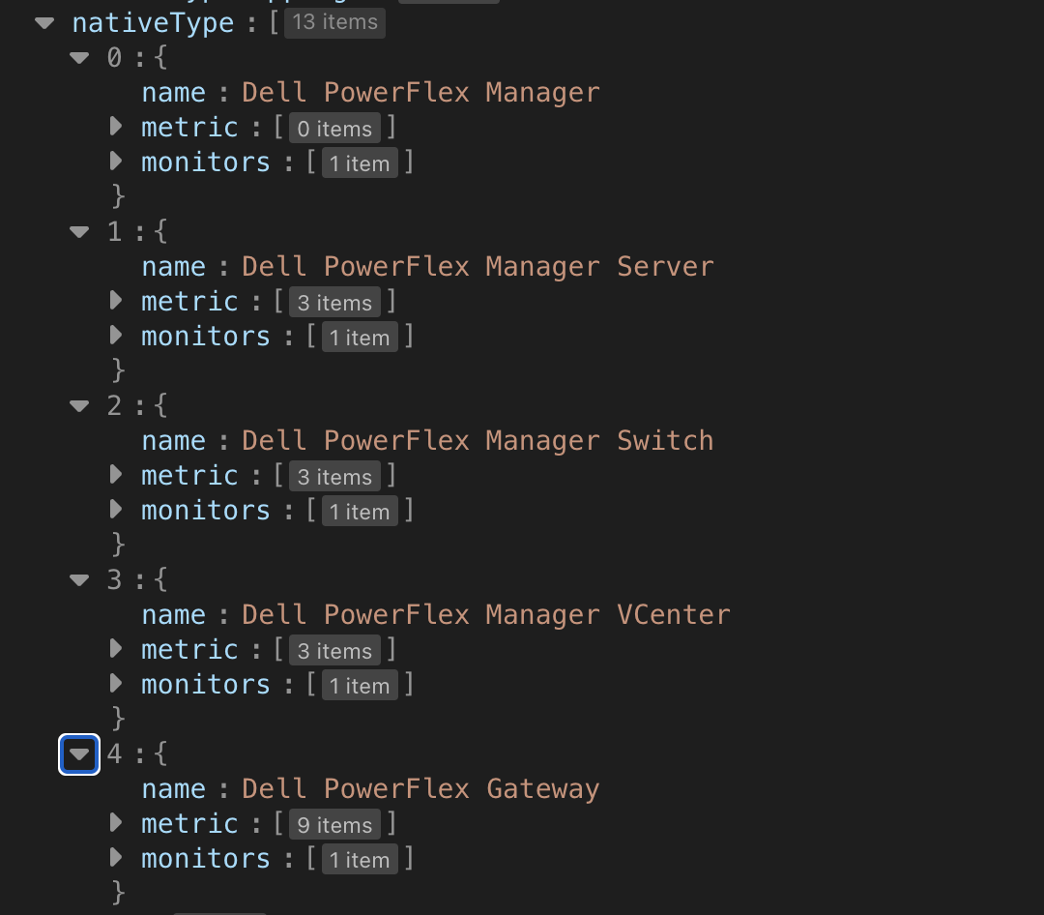
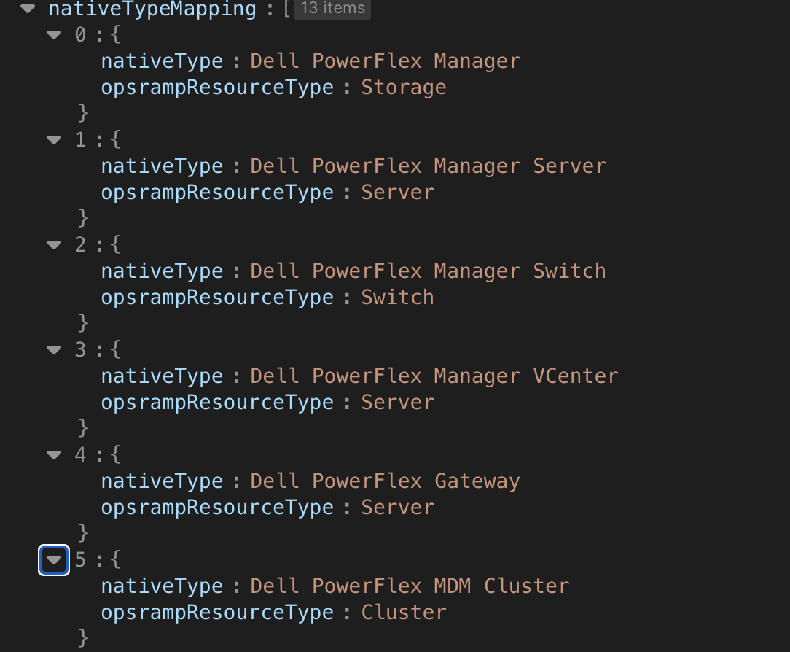
Resource - Example
nativeType to OpsRamp’s ResourceType:
nativeTypes

Slide 11
Resource Relationships
Target device
Captures different relationships between “resource types”
“runsOn”
Eg: “VMs runs on a host”
Eg: “OS runs on a server”
“connectedTo”
Eg: “this port is connected to that port”
Eg: “this host is connected to that switch”
Eg: “this router is connected to that router”
“dependsOn”
Eg: “VM depends on a datastore”
Eg: “datastore depends on a volume”
Eg: “volume depends on a disk”
“componentOf”
Eg: “node is a member of a cluster”
Eg: “NIC is part of a host”
Eg: “disk is part of a server”
Resource Type 1
Resources
Relationship
Resources
Resource Type 2
https://github.com/opsramp/sdk2.0/blob/main/documentation/relationship.md

Slide 12
Metric
Target device
Identifies the actual metric of monitoring interest
“disk-utilization”, “packets-in”, “packets-out”, “memory utilization” etc.,
Captures how this metric is to be graph’d/rendered
Display as a gauge, displayName, description etc.,
Includes an “alert” definition
A “default” warning threshold
A “default” critical threshold
Should this metric ever raise an alert or not
Resource Type 1
Resources
Metric
Graph
Alert

Slide 13
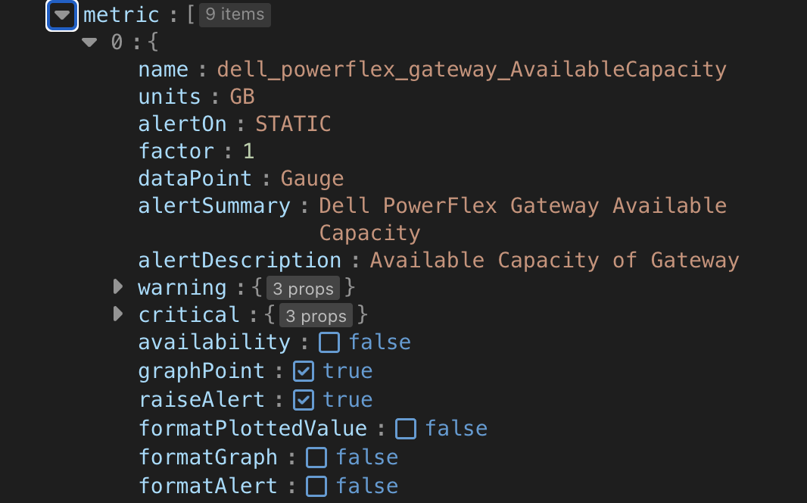
Metric - Example

Slide 14
Monitor
Target device
Encapsulates all related metrics into a single object
Contains one or more metrics previously defined
Defines a default monitoring frequency
All metrics in a monitor are polled at this frequency
The App will get a “Monitor Message” per monitor at this specified frequency.
Each Monitor definition translates into a “Template” object in the cloud
The template serves as a blueprint for how to monitor this target type in “all” targets in an environment
Resource Type 1
Resources
Monitor
Metrics

Slide 15
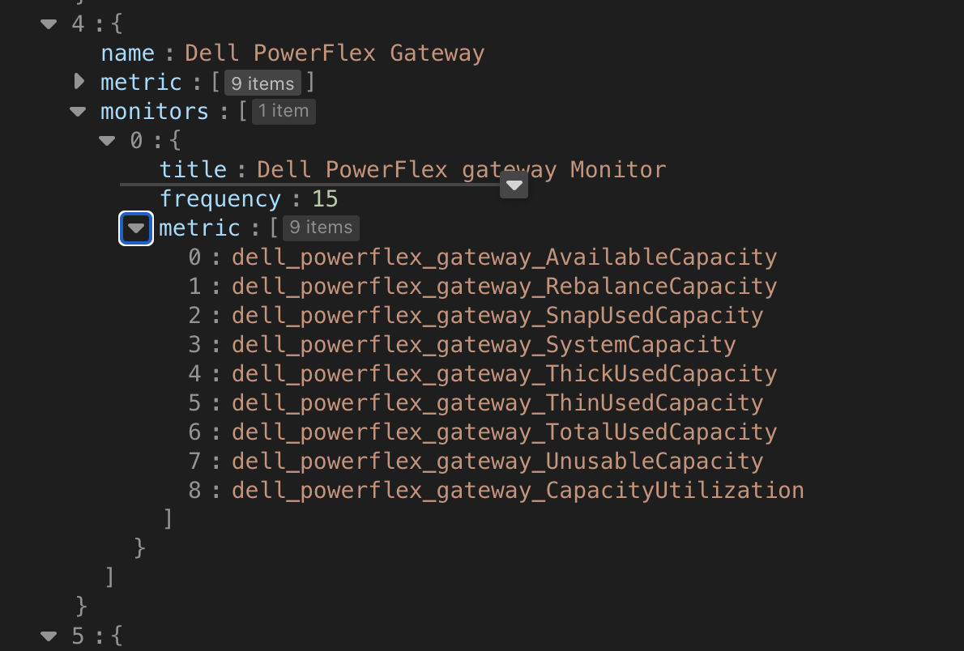
Monitor - Example
monitor:
nativeTypes

Slide 16
Template
Target device
Template objects are automatically created in the cloud when a App is “published” into the platform
They serve as a blueprint for how to monitor all resources discovered of certain type
Highly customizable
Resource Type 1
Resources
Template
Monitors

Slide 17
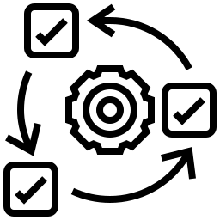
DMP (Device Management Policy)
The engine is triggered every time a resource is discovered or updated:
Looks for a match to take an action
One of the many actions is “Assign this monitoring template” to the matched resource
Matched template(s) are then sent from the cloud to the gateway
Gateway core services deliver these messages as “monitor message” to the app
Resource Attribute Match specifications:
aka. “filter criteria”
Policies
input
selects
Template object(s)
Dynamic always-on
Policy Engine
look here for more on DMP

Slide 18
Overall Training Agenda
Basic Concepts
App Development
Define
Develop
Publish
Install
Customize
Debug
Message Flows

Slide 19
App development - Stages
Define
Develop
Publish
Install
Customize
Domain Model
App Manifest
Generate Code
Fill Stubs
Build
Complete manifest
Register the app in cloud
Configure credentials
Deploy into your gateway
Customize monitoring and Alert thresholds

Slide 20




Define the App - Domain Model
app-manifest.json
POST
Publish
generates
input
generates
OpsRamp Provided Tool
(Code Generator)
target-domain.json
app.py, packages etc.,
Note: “publish” here is just telling OpsRamp Cloud what and where the app images are. You publish your app container image into your favorite registry. Then, just add those registry details in the manifest. Those registry details will make their way to the gateway at the install time and the gateway core will pull the image from the specified registry.

Slide 21
Define the App - Domain Model
sections:
{
"appName": "dell-powerflex",
"appVersion": "1.0.0",
"discoveryConfiguration": [],
“required”: [],
“nativeType: [],
“nativeTypeMapping: [],
“data”: {}
}
1.Name/Version
2.Configuration
3.Native Types
4.Native Type Mapping
5.Misc.
target-domain.json

Slide 22
Domain Model - Configurations
{
"appName": "dell-powerflex",
"appVersion": "1.0.0",
"discoveryConfiguration": [],
“required”: [],
“nativeType: [],
“nativeTypeMapping: [],
“data”: {}
}
Specifies various inputs required to authenticate the connection with the target
Code generator uses this minimum information to generate “JSON Forms”
OpsRamp Cloud will render the UI based on this JSON form when the app is installed on a gateway
OpsRamp Cloud will send the configuration information to the app
target-domain.json

Slide 23
Domain Model - Discovery configurations
"discoveryConfiguration": [
{
"propertyName": "isSecure",
"label": "Is Secure",
"dataType": "boolean"
},
{
"propertyName": "dellFlexGatewayIP",
"label": "Dell PowerFlex Gateway IP Address",
"dataType": "string"
},
{
"propertyName": "gatewayCredentials",
"label": "Dell PowerFlex Gateway Credentials",
"dataType": "string",
"credentialType": "APPLICATION",
"placeholder": "Select Credentials"
},
…
],
domain.json
{
"appName": "dell-powerflex",
"appVersion": "1.0.0",
"discoveryConfiguration": [],
“required”: [],
“nativeType: [],
“nativeTypeMapping: [],
“data”: {}
}
target-domain.json

Slide 24
Domain Model - NativeTypes
{
"appName": "dell-powerflex",
"appVersion": "1.0.0",
"discoveryConfiguration": [],
“required”: [],
“nativeType: [],
“nativeTypeMapping: [],
“data”: {}
}
Native Types as described before
Native Type mappings as described before
target-domain.json

Slide 25
Build the App
Run the domain-model.json through the code generator
Tool generates the App manifest
Tool also generates a lot of python code with the necessary stub routines empty
All the developer will need to do is to complete the stub code for Discovery and Monitoring methods
Build the python code using your IDE, build the container images using your own CI/CD and push those images into your favorite registry. OpsRamp has no say on how you build your apps and publish your container images.
Once all done, just include a link the to the chart repo in the App manifest
You are now ready to publish this app into OpsRamp

Slide 26

Publish the App
Available Apps (Scope: Global, Partner, Client)
app-manifest.json
POST
adds-to
App1
App2
Appn
Publish

Slide 27
Publish the App
Apps can be published into Global, Partner and Client scope
Global - App is visible as available to all partners and clients
Partner - App is visible to the specific partner and all clients in that partner
Client - App is visible to only the specific client
Once published and is available, the app is then available to be deployed into one or more gateways in a specific client

Slide 28
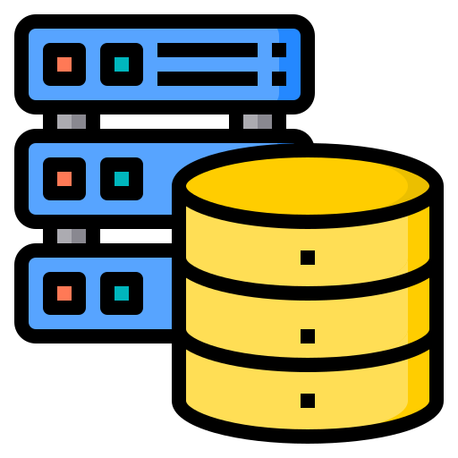
Install the App
app-manifest.json
Available Apps (Scope: Global, Partner, Client)
POST
adds-to
App1
App2
Appn
Publish
install
App1
Gateway
Target

Slide 29
Install the App
Select the app to install
Select the gateway to install the app into
Core services on the gateway will install the app based on the helm data in the manifest
Once the app is ready, then the core services will send the configuration messages to the app to get the discovery started
Once the discovery finishes, then the monitoring will start and will repeat as per the specified frequency

Slide 30
Installed app - communication to cloud
OpsRamp
SaaS
(Cloud)
Gateway
Core
Side
Car
App
K8S Pod
K8S Pod
Nextgen Gateway

Slide 31
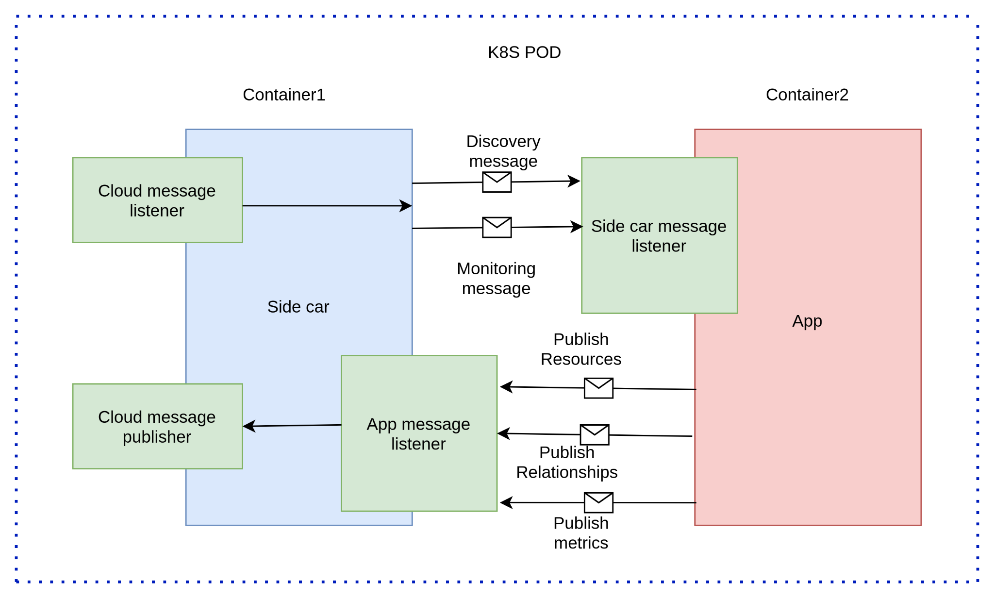
Installed app - Anatomy

Slide 32
Customize the App
As specified before the monitors become templates in the cloud
Templates are applied to a app on a gateway
The Templates therefore allow each app to drive monitoring specific to the target being monitored by the app

Slide 33
Overall Training Agenda
Basic Concepts
App Development
Message Flows

Slide 34
Cloud to Gateway message processing
App lifecycle messages [details]
Discovery messages [details]
Monitoring messages [details]
Credential messages [details]
Resource messages [details]
Ack message [details]

Slide 35
Side car to App message processing
App bootstrap [details]
Discovery message [details]
Monitoring message [details]
Event message [details]

Slide 36
App to sidecar message processing
Resource message [details]
Relationship message [details]
Metric message [details]
Alert message [details]

Slide 37
Sidecar to cloud message processing
Resource message[details]
Relationship message[details]
Metric message[details]
Alert message[details]

Slide 38
Backup

Slide 39
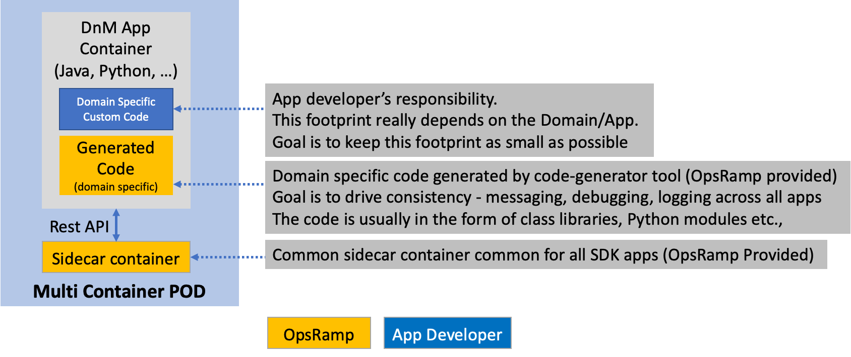
Anatomy of a SDK App (from 3rd Party view)

Slide 40
Gateway setup and debugging
Setup and Debugging

Slide 41
Cloud reports forms and customizations
Partner and client view
Integrations and manage Apps view
Resource and component discovery reports
Metric reports
Alert reports
DMP, Template and Metric reports and forms
DMP, Template and Resource customizations
Dashboards 2.0
Topology

Slide 42
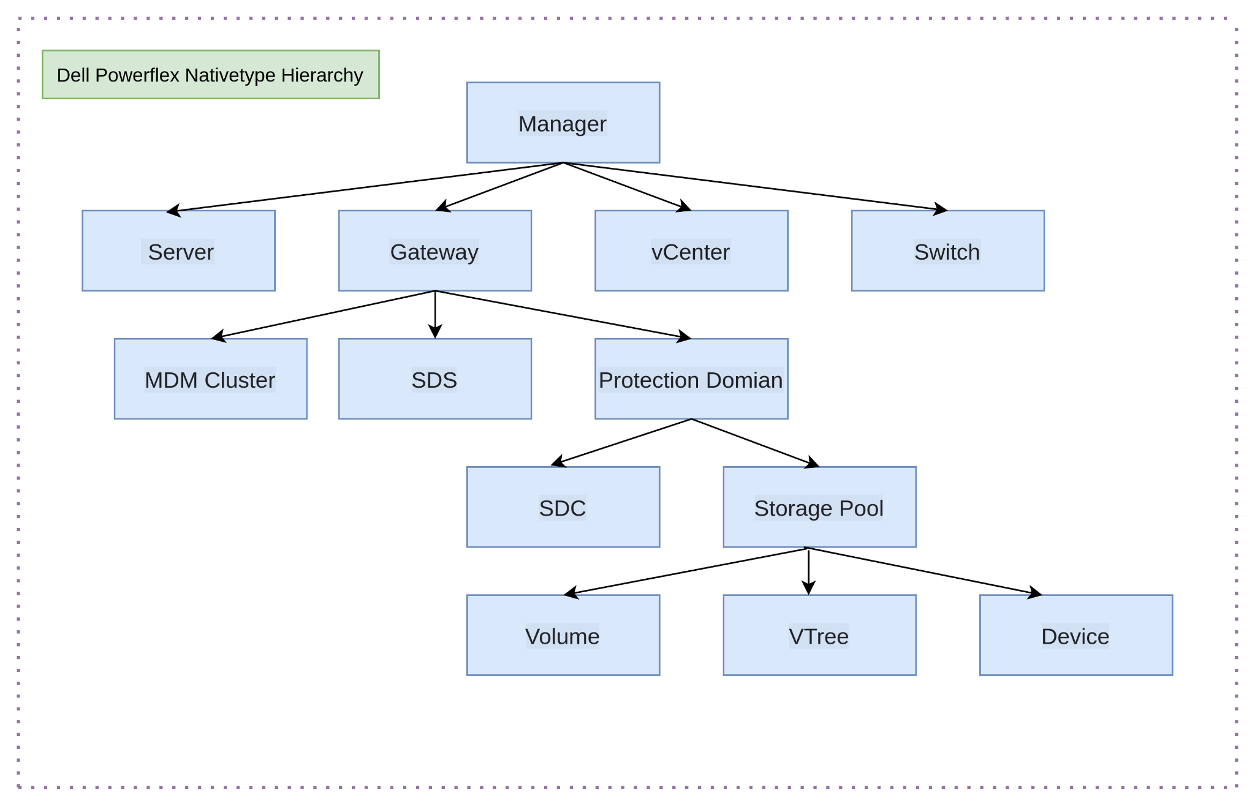

Slide 43
Nativetype to Resourcetype mapping
Native Type | Resource Type
Dell PowerFlex Manager | Storage
Dell PowerFlex Manager Server | Server
Dell PowerFlex Manager Switch | Switch
Dell PowerFlex Manager VCenter | Server
Dell PowerFlex Gateway | Server
Dell PowerFlex MDM Cluster | Cluster
Dell PowerFlex SDS | STORAGE_ARRAY
Dell PowerFlex Protection Domain | STORAGE_ARRAY
Dell PowerFlex SDC | STORAGE_ARRAY

Slide 44
Nativetype to Resourcetype mapping [continue]
Native Type | Resource Type
Dell PowerFlex Storage Pool | STORAGE_ARRAY_POOL
Dell PowerFlex Volume | Storage
Dell PowerFlex VTree | Volume
Dell PowerFlex Device" | Storage

Slide 45
Resource Definition[ Resource name: idrac-2NC6BL3, Resource Type: Server]
Resource Attribute | Value
resourceType | Server
nativeType | Dell PowerFlex Manager Server
resourceName | idrac-2NC6BL3
moId | 8abcd9288061605a01806677dd1237e6
hostName
os | VMware ESXi

Slide 46
Resource Definition[ Resource name: idrac-2NC6BL3 , Resource Type: Server][continue]
Resource Attribute | Value
make | Dell
model | PowerEdge R650
ipAddress | 10.60.39.216
hasRelationship | true
tags | {"Device Type": "RackServer", "Service Tag": "2NC6BL3"}},

Slide 47
Resource Definition[ Resource name: /dev/sde, Resource Type: Storage]
Resource Attribute | Value
resourceType | Storage
nativeType | Dell PowerFlex Device
resourceName | /dev/sde
moId | 797757a200010004
hostName | /dev/sde
serialNumber | V2X165MY
model | WUSTVA196BSS200
hasRelationship | true
tags | {"Media Type": "SSD", "Device Type": "Scsi", "Vendor Name": "WDC"}

Slide 48
Relationship Definition
Native Type: Dell PowerFlex Storage Pool |  | Native Type: Dell PowerFlex Device
Source Resource moID | Relationship | Target Resource moID
fe7a72a300000000 | memberof | 797757a200010004
fe7a72a300000000 | memberof | 797757a300010005
fe7a72a300000000 | memberof | 797757a400010006
fe7a72a300000000 | memberof | 797b579c00020008

Slide 49
Metric Definition[Resource Type: Storage , Resource Name: stage-pflex-gateway-System]
metricName | instanceValue | timestamp
dell_powerflex_gateway_AvailableCapacity | 160720.0 | 1657794224
dell_powerflex_gateway_RebalanceCapacity | 0.0 | 1657794224
dell_powerflex_gateway_SnapUsedCapacity | 0.0 | 1657794224
dell_powerflex_gateway_SystemCapacity | 160784.0 | 1657794224
dell_powerflex_gateway_ThickUsedCapacity | 0.0 | 1657794224
dell_powerflex_gateway_ThinUsedCapacity | 0.0 | 1657794224

Slide 50
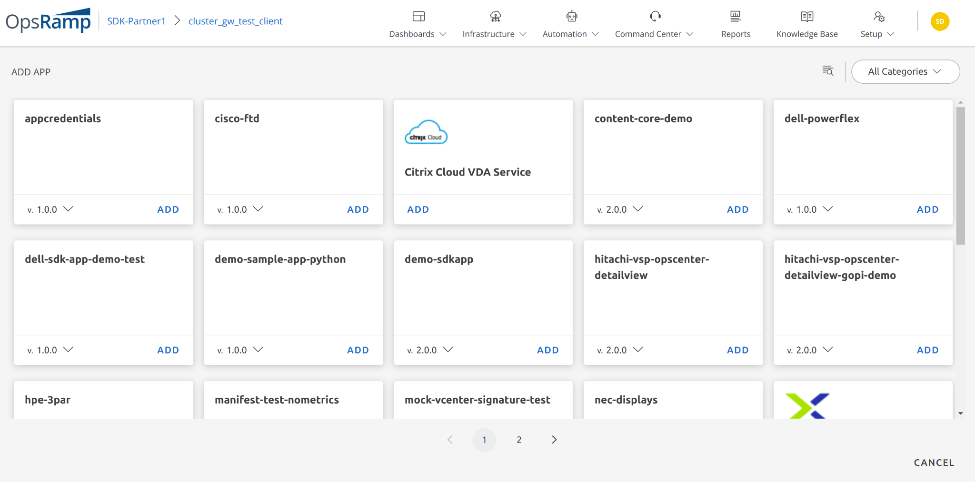
Available Apps

Slide 51
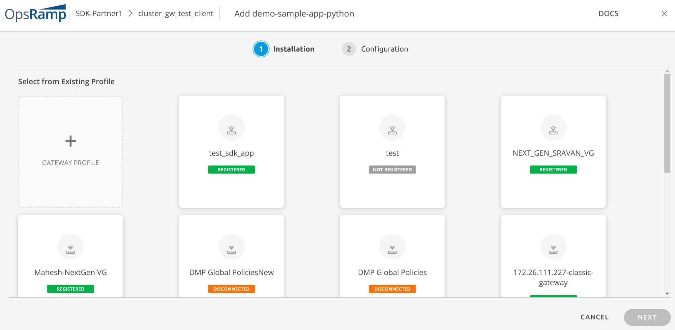
Install App

Slide 52
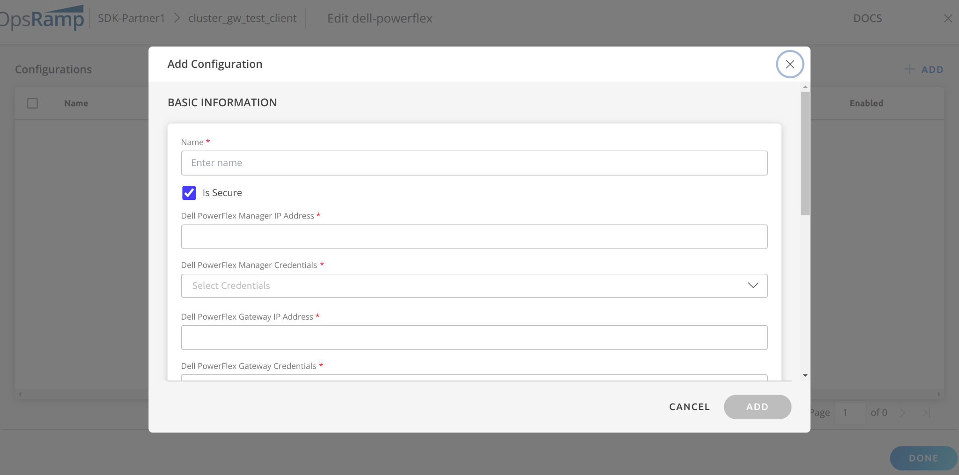
Install Configuration

Slide 53
Manifest.json
Domain.json
Publish App
App developer
Code Generator

